Slide 2
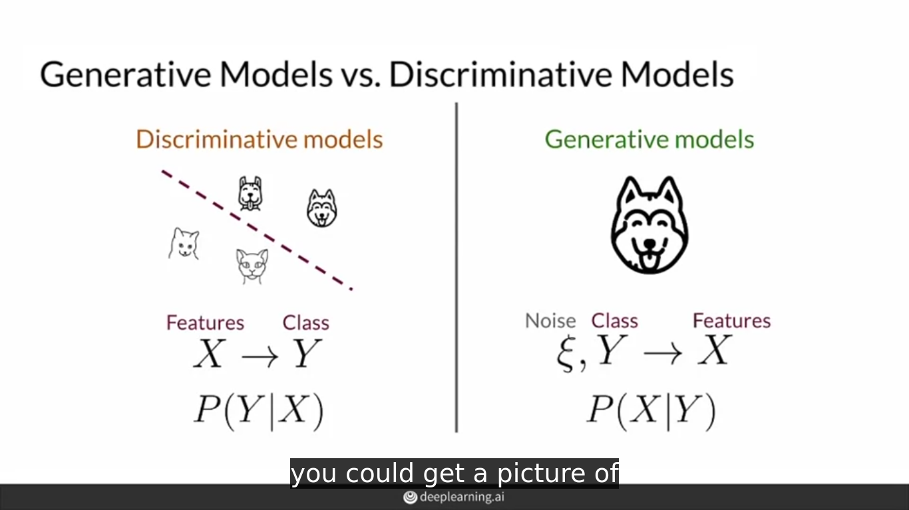

Slide 3
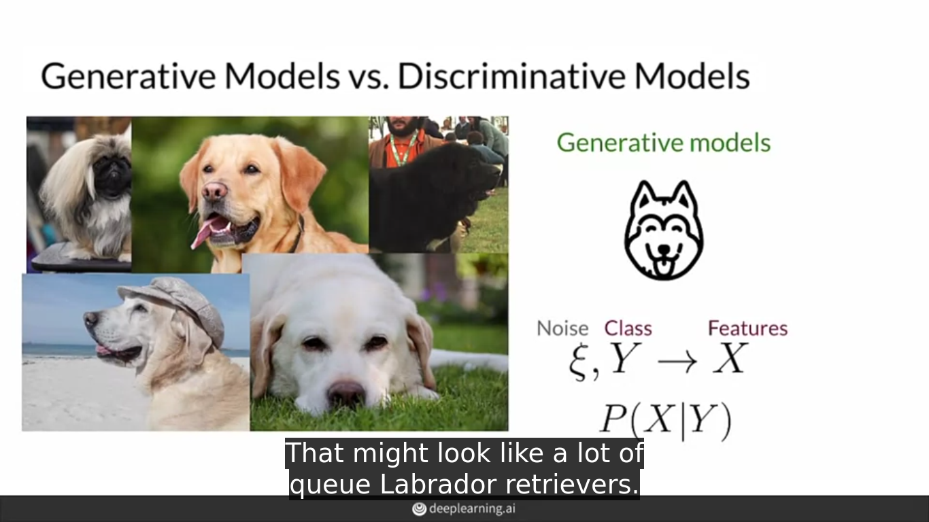

Slide 4
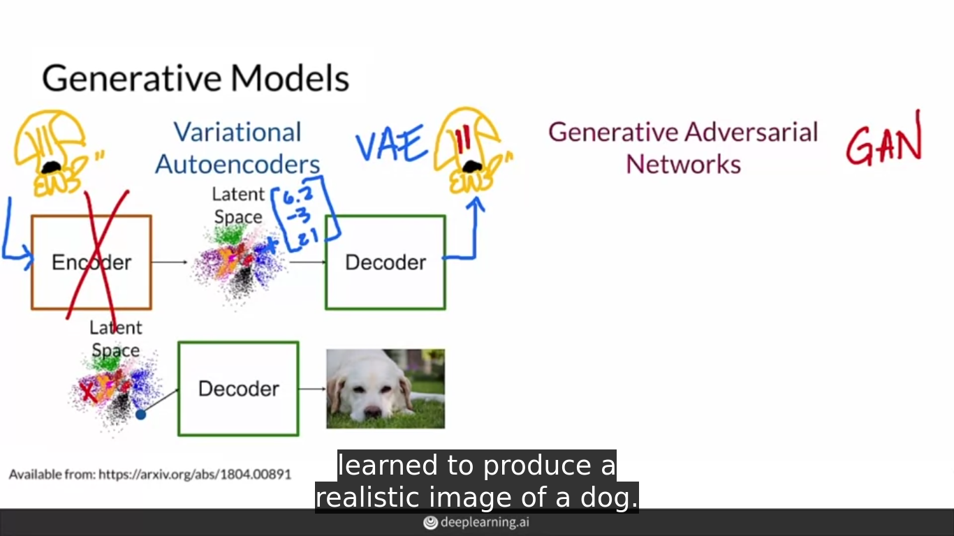

Slide 5
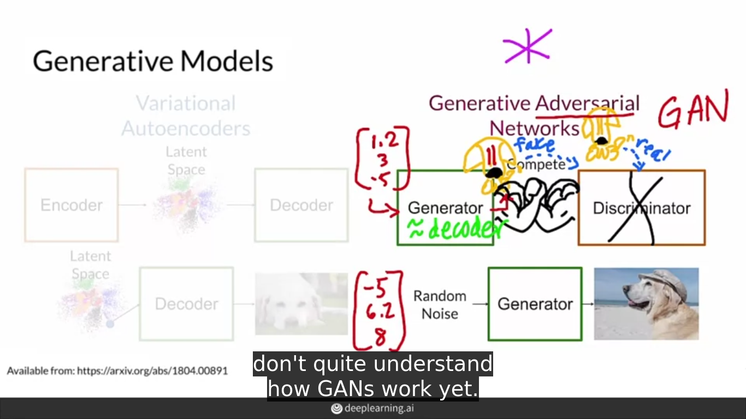

Slide 6
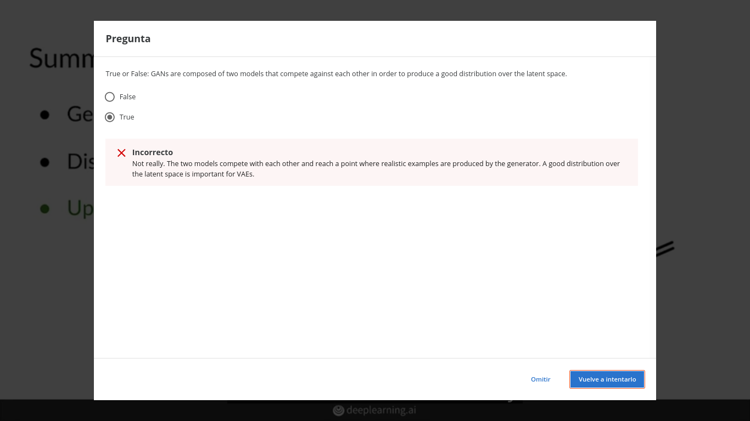

Slide 7
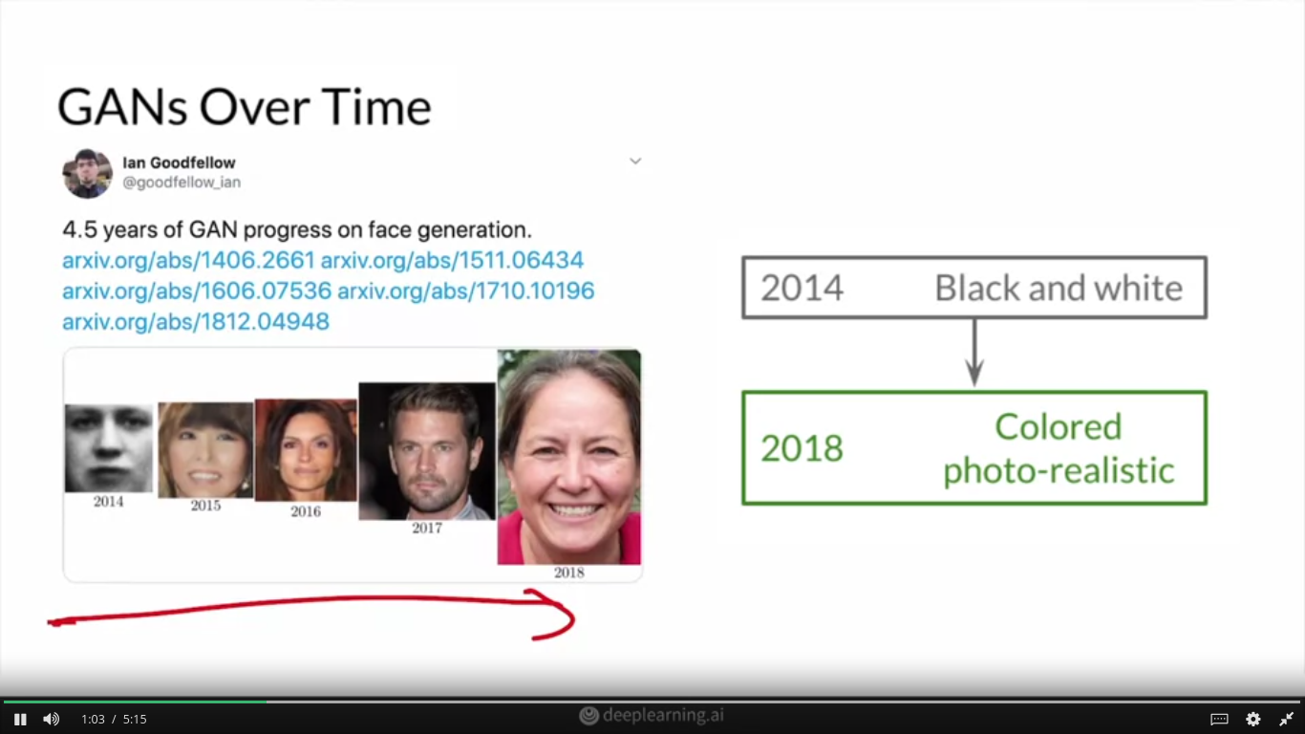

Slide 8
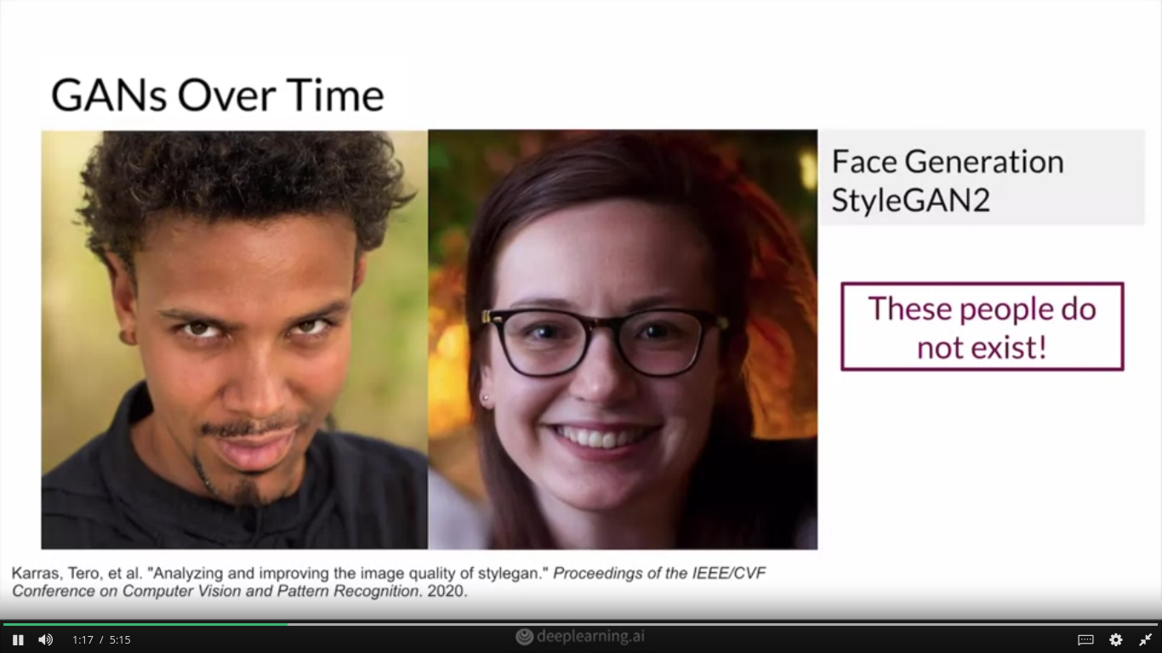

Slide 9
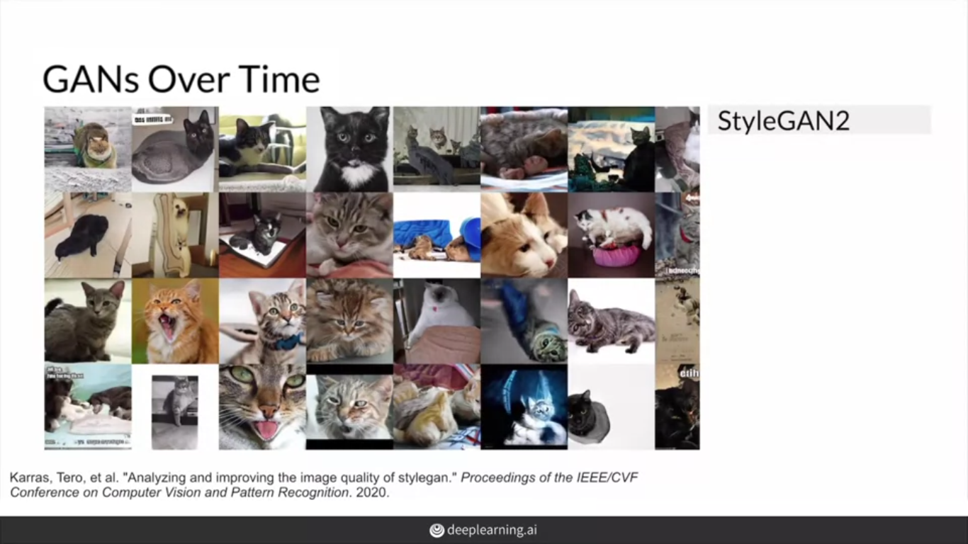

Slide 10
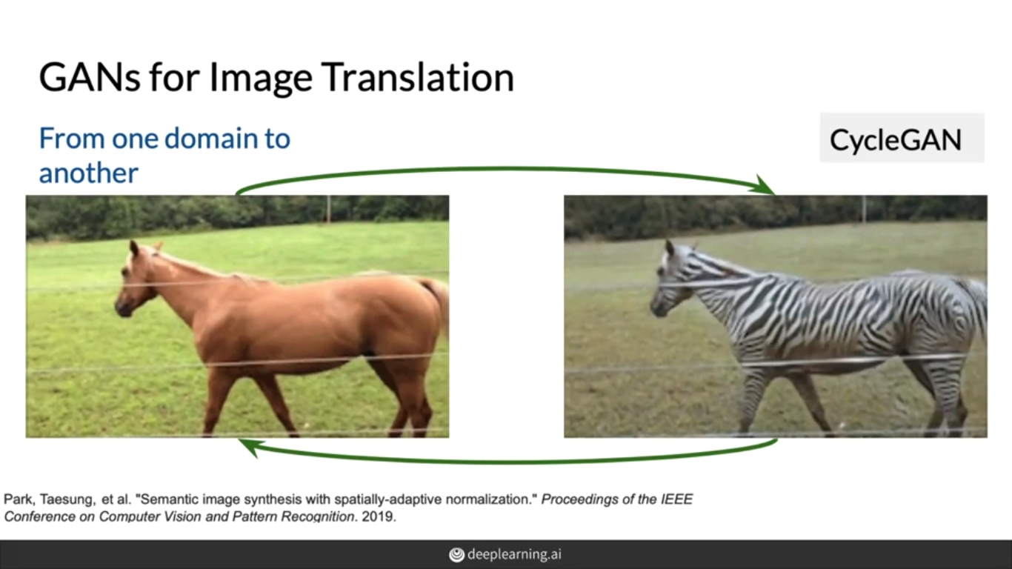

Slide 11
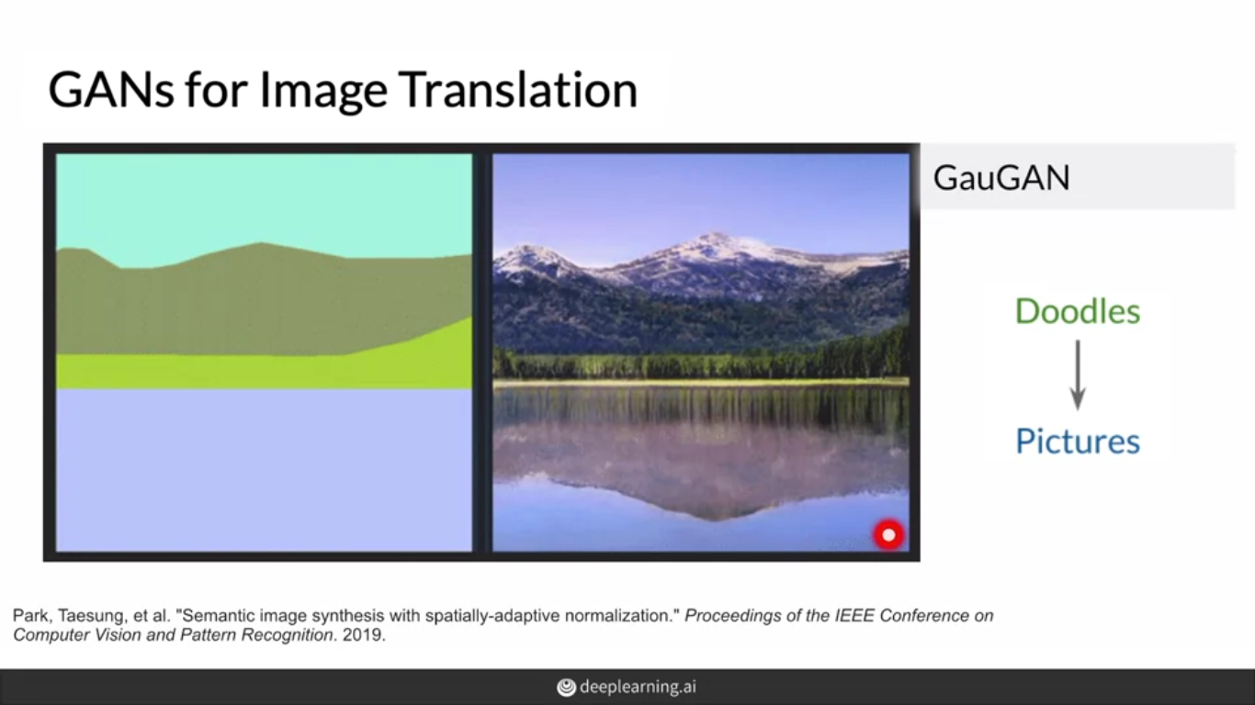

Slide 12
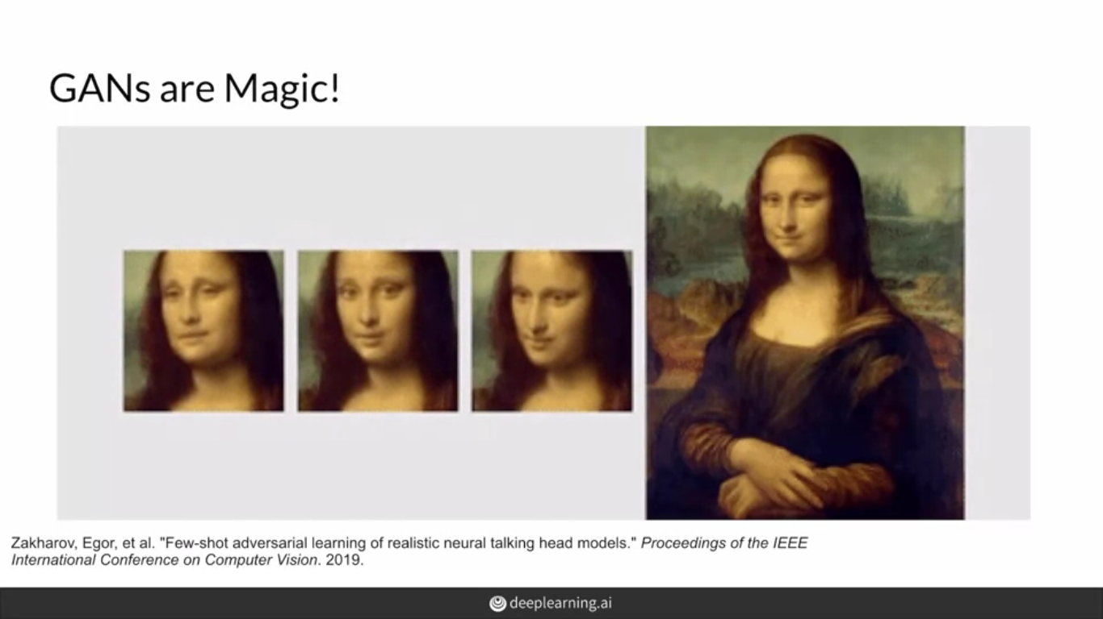

Slide 13
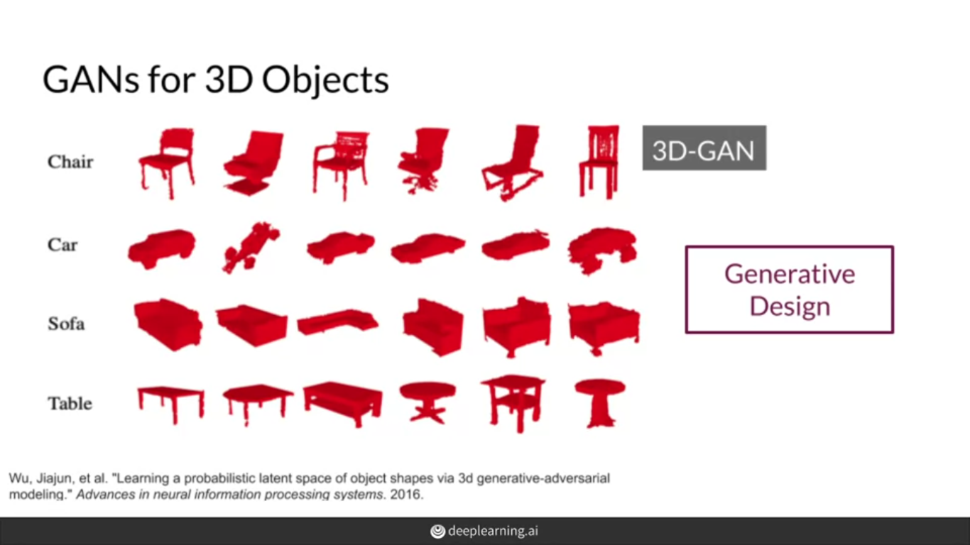

Slide 14
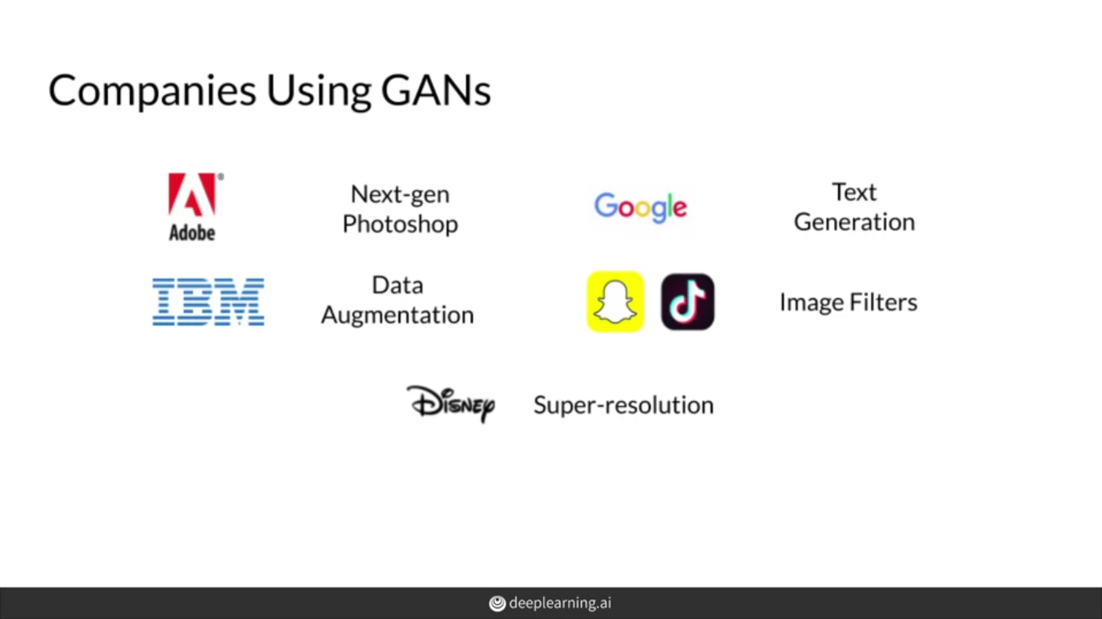

Slide 15
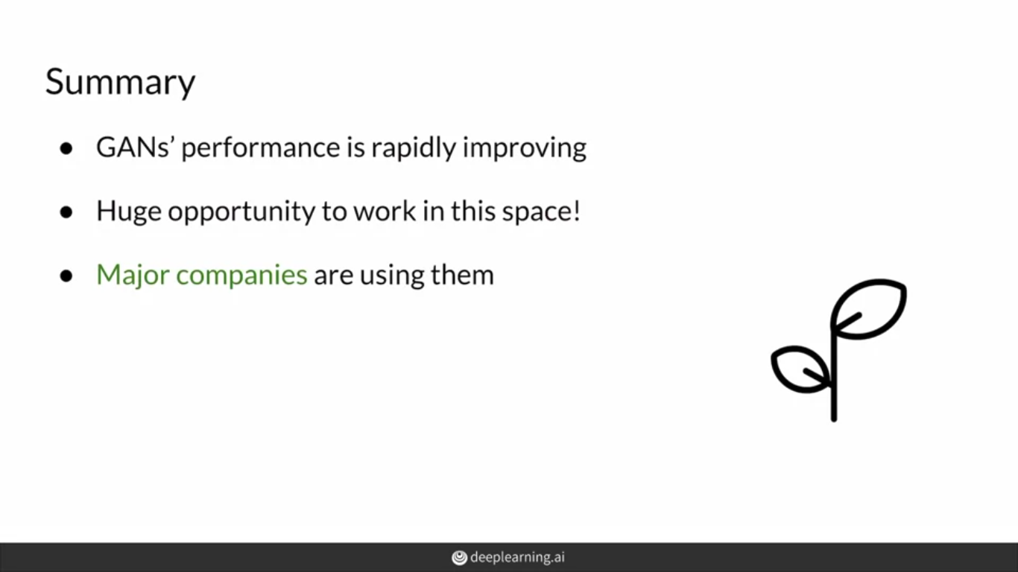

Slide 16
https://www.thispersondoesnotexist.com/
http://thesecatsdonotexist.com/

Slide 17
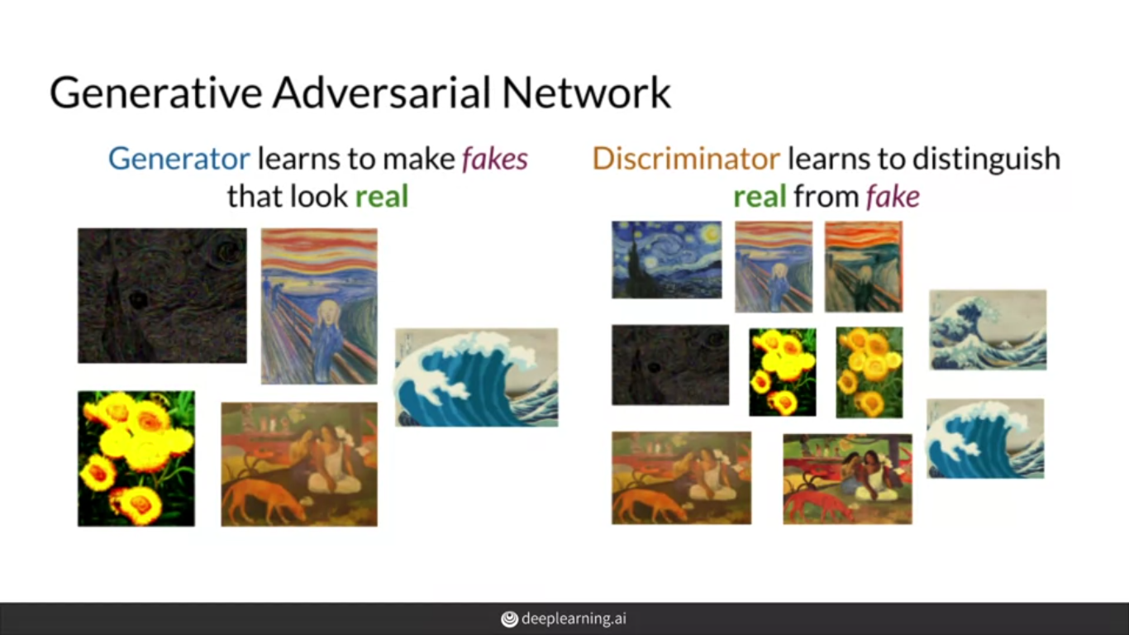

Slide 18
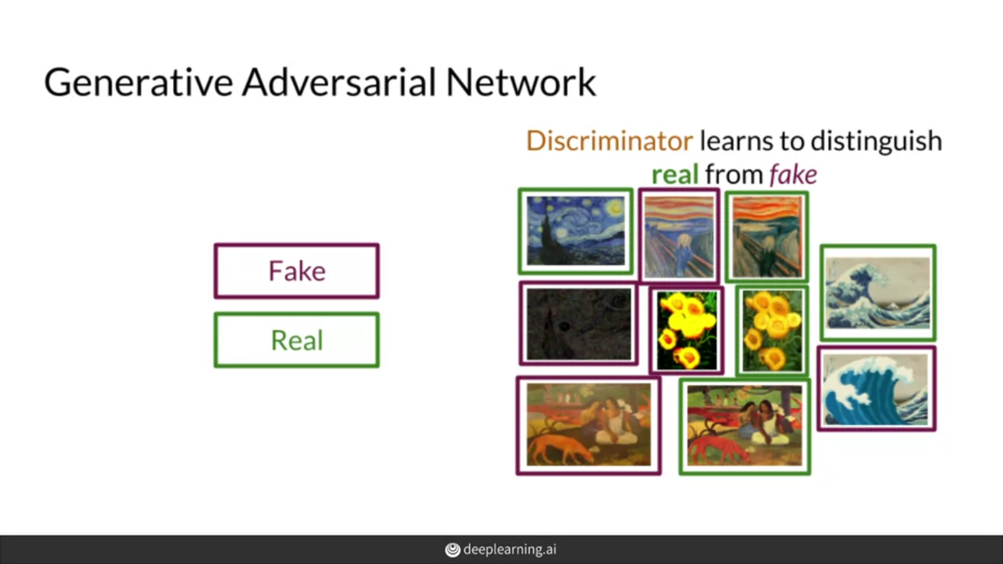

Slide 19
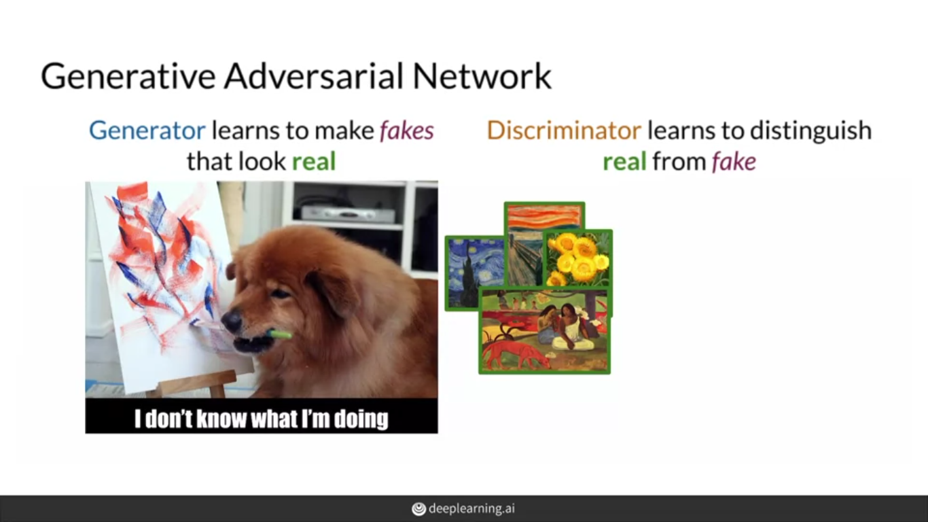

Slide 20
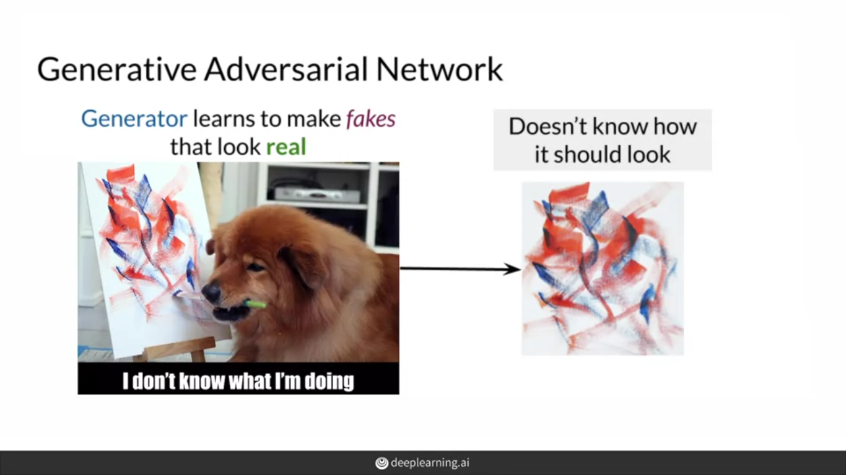

Slide 21
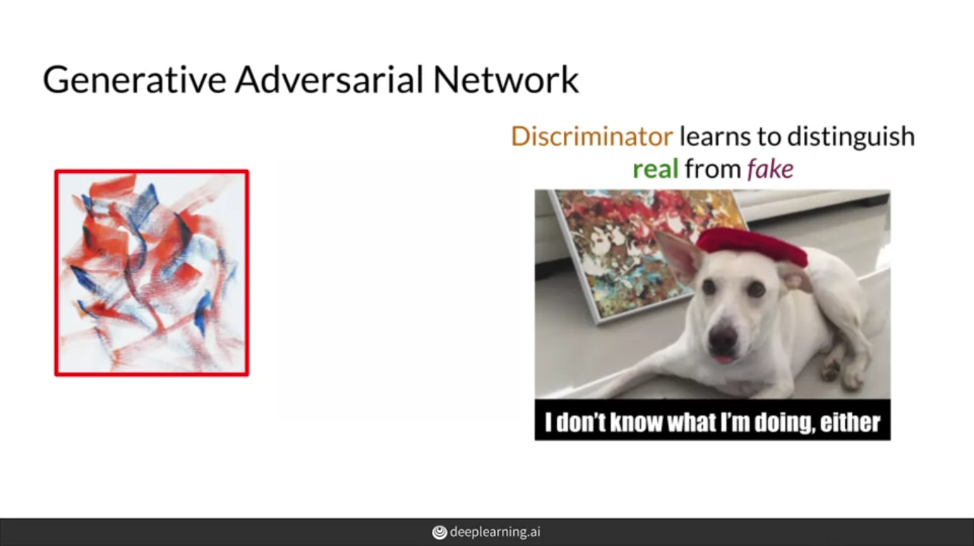

Slide 22
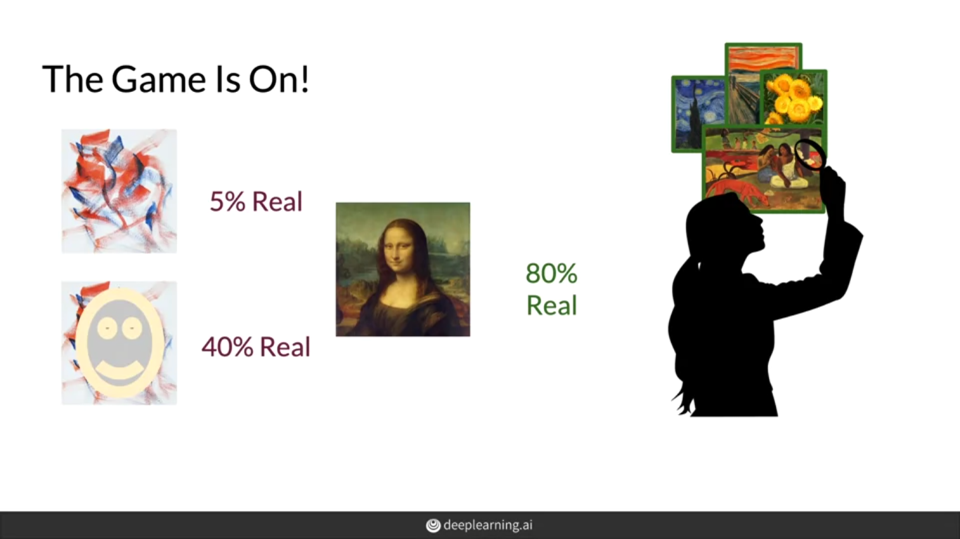

Slide 23
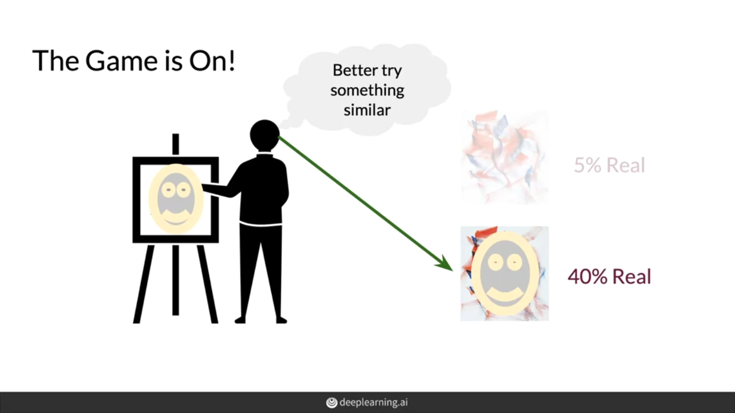

Slide 24
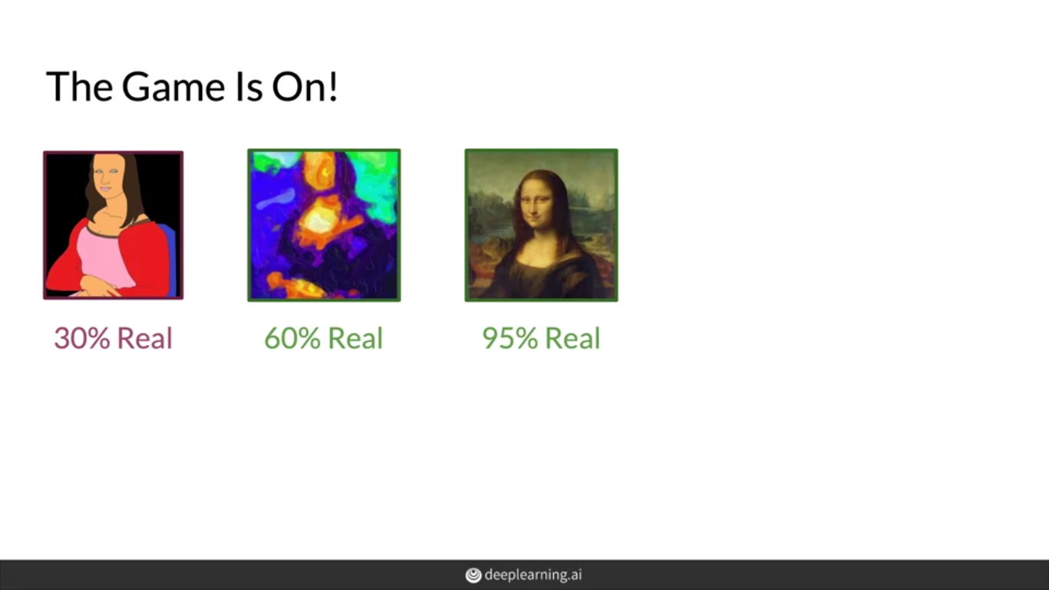

Slide 25
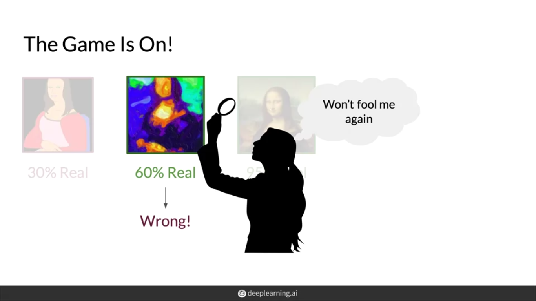

Slide 26
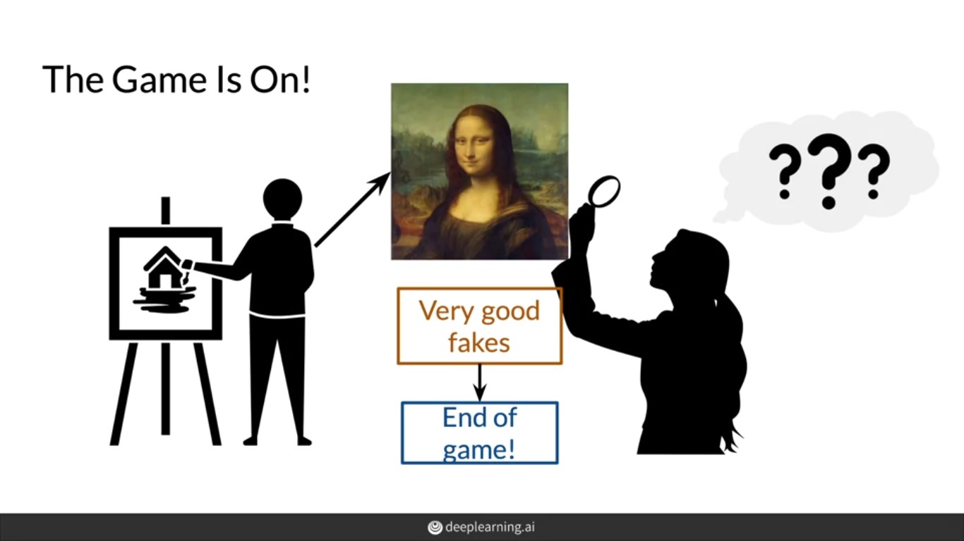

Slide 27
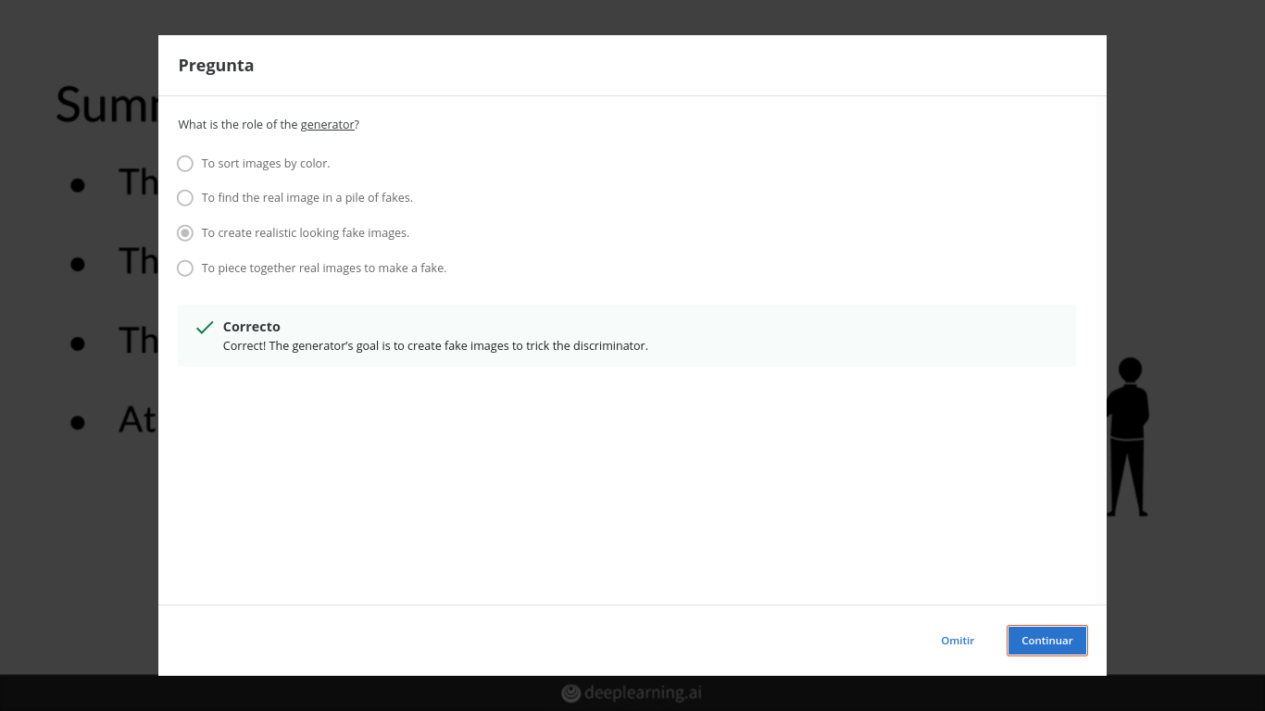

Slide 28
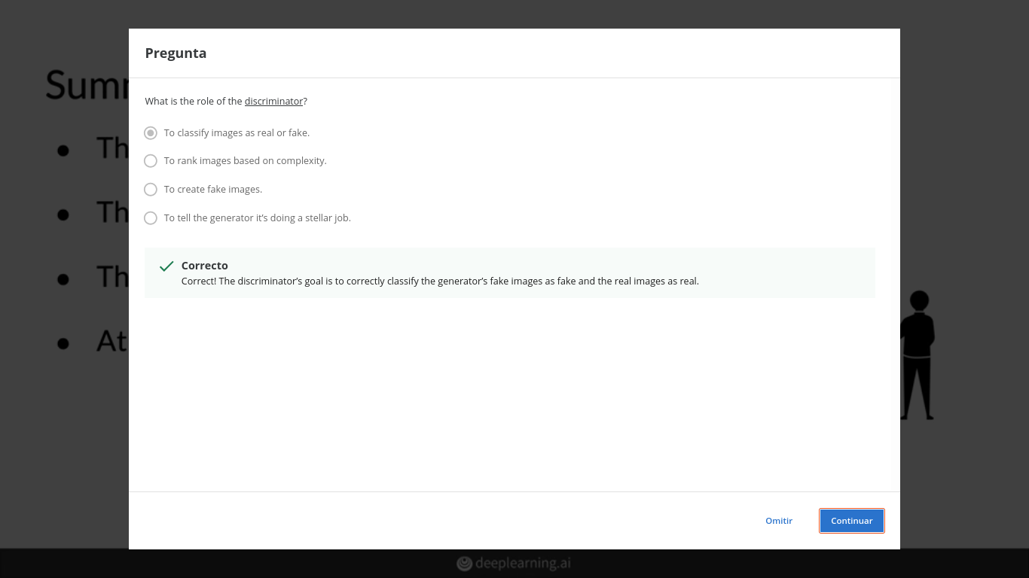

Slide 29
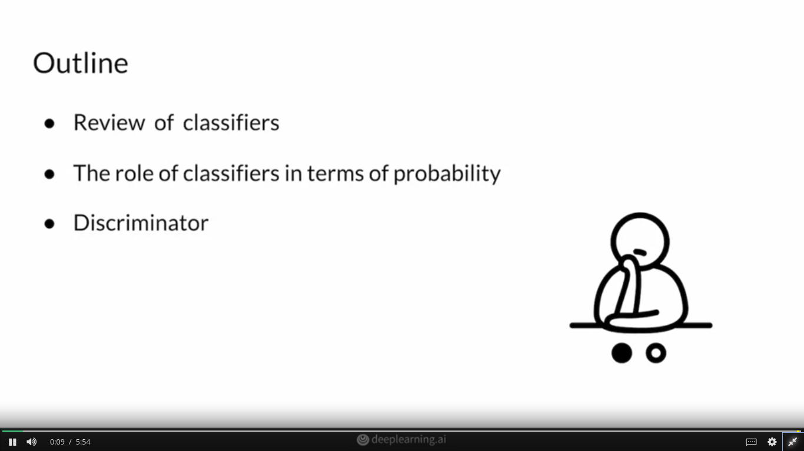

Slide 30
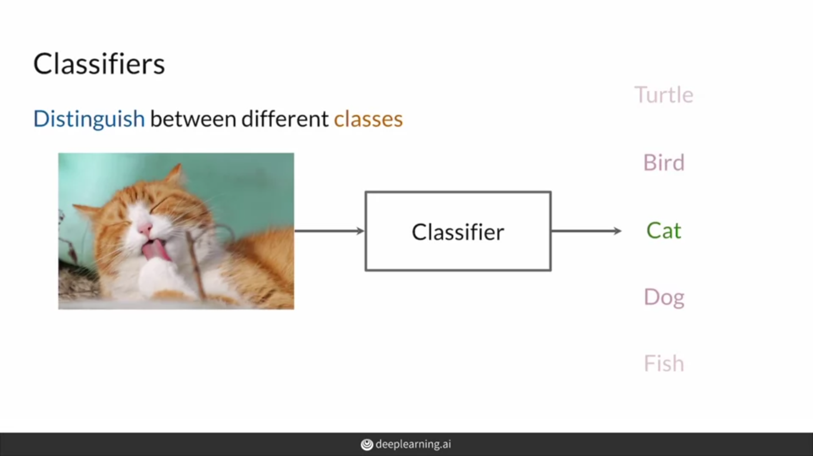

Slide 31
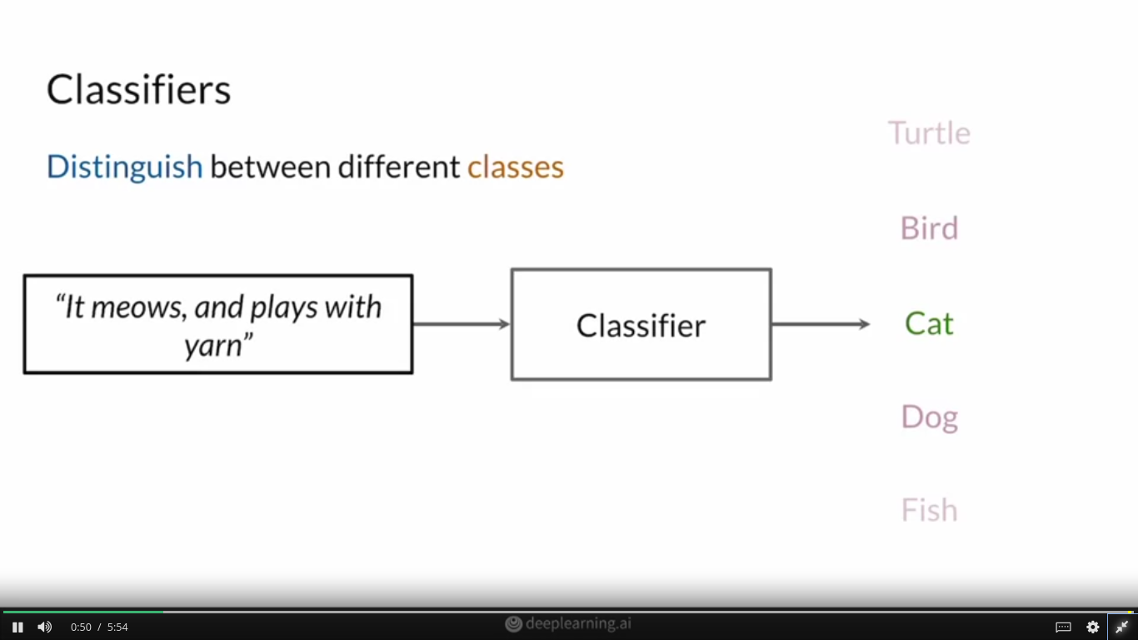

Slide 32
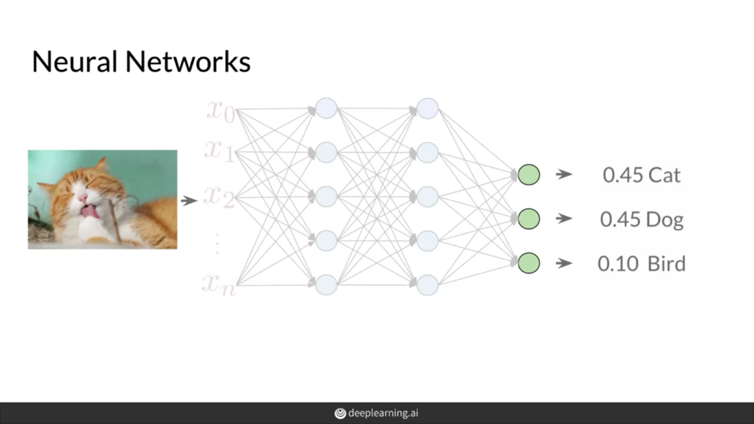

Slide 33
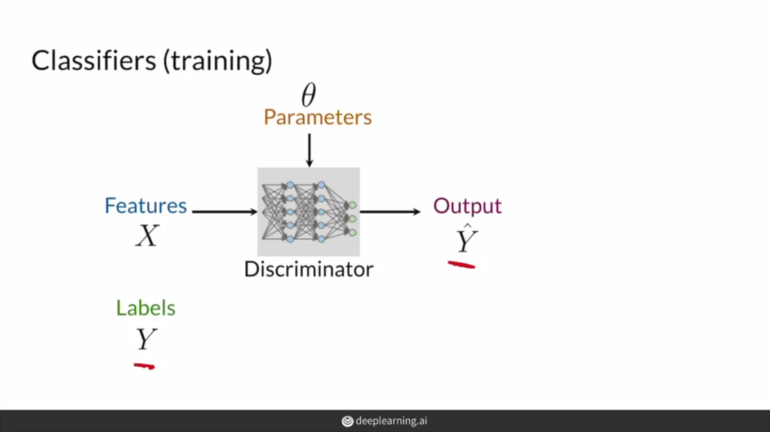

Slide 34
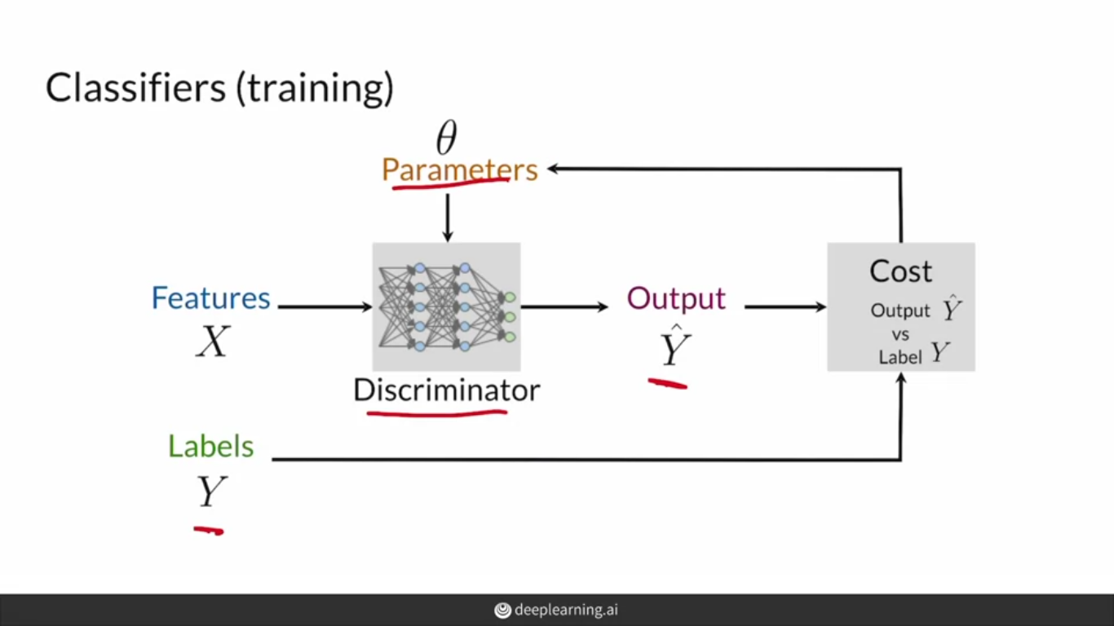

Slide 35
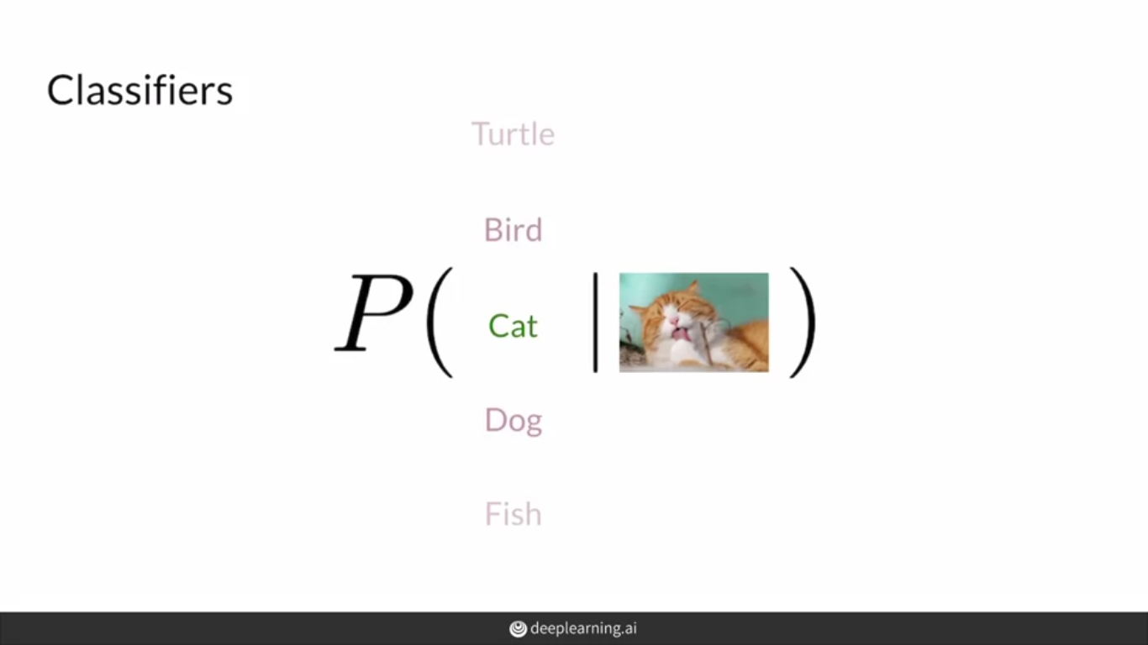

Slide 36
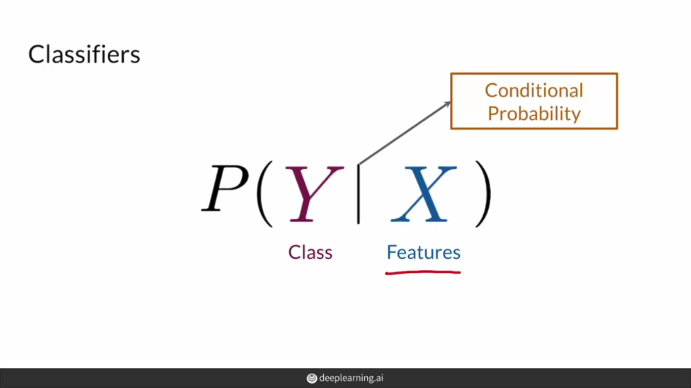

Slide 37
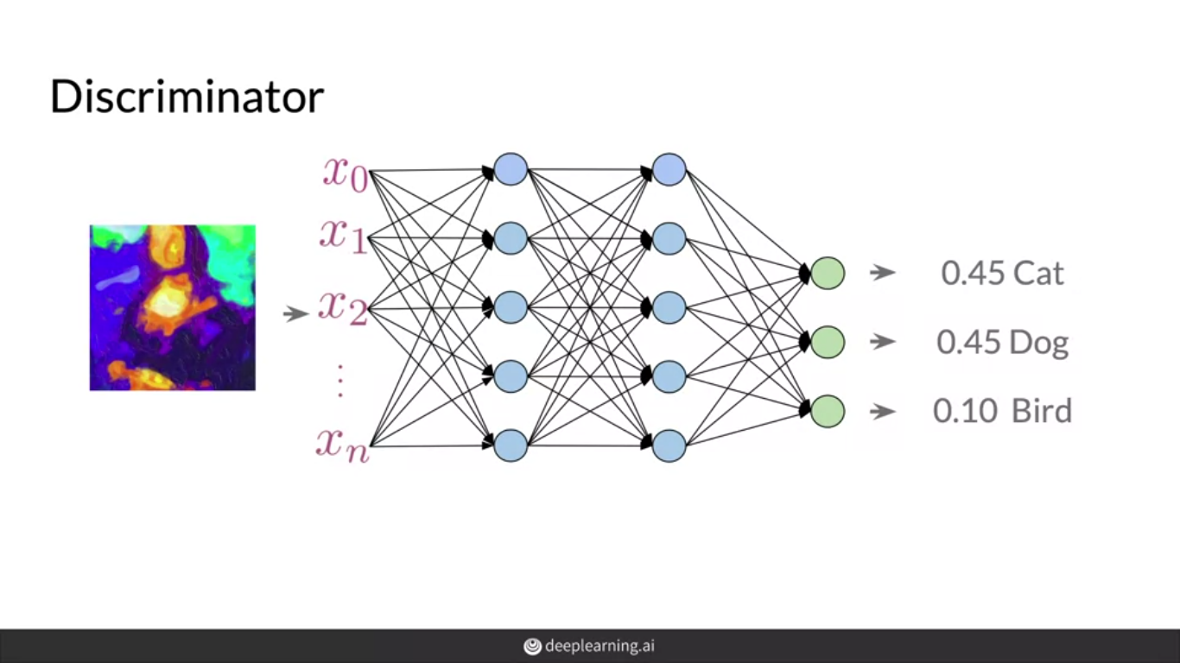

Slide 38
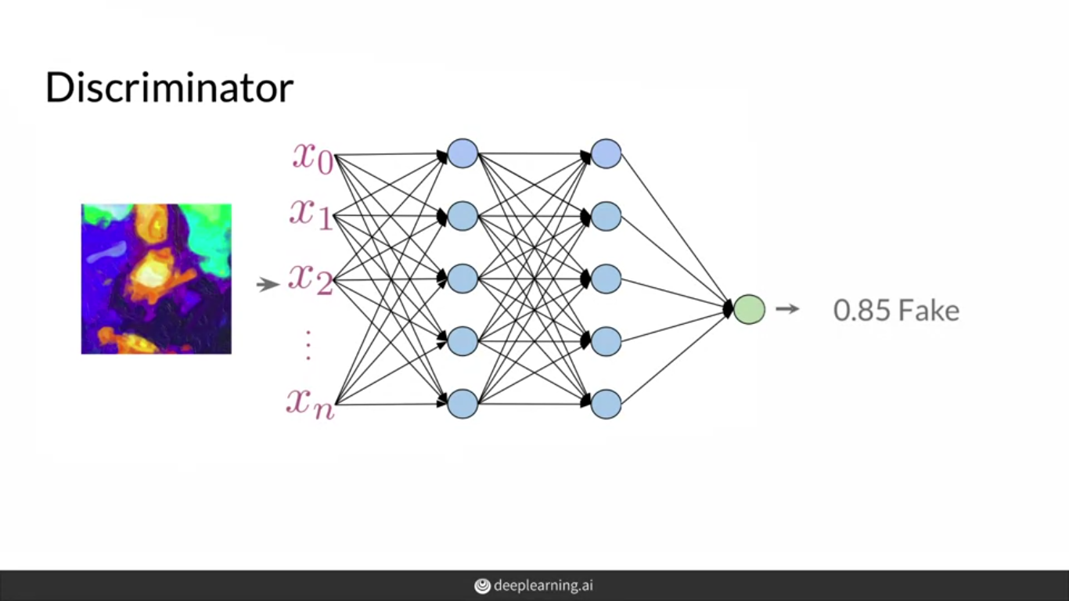

Slide 39
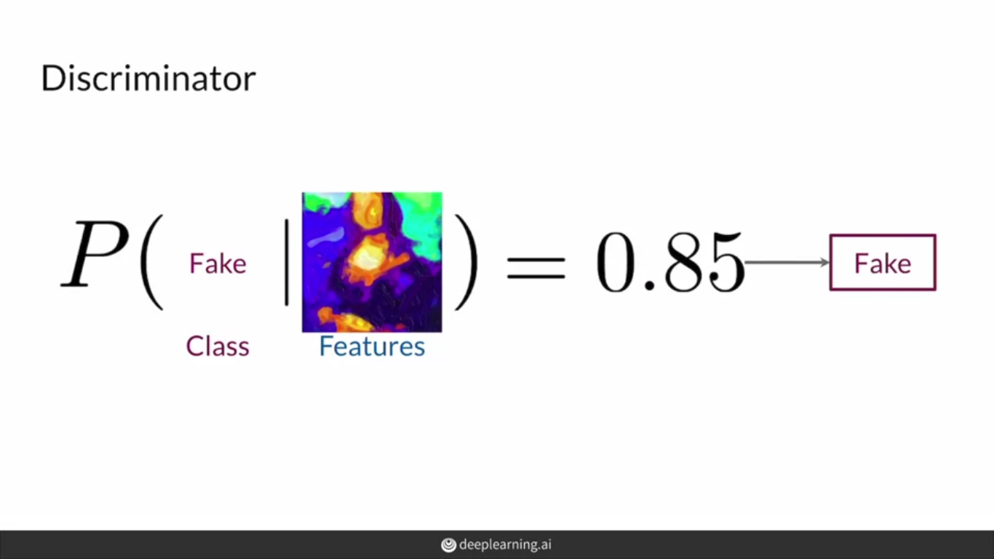

Slide 40
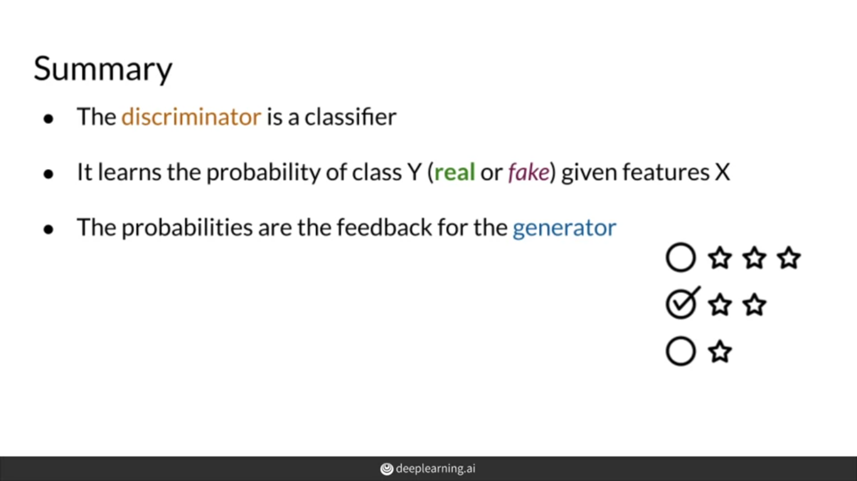

Slide 41
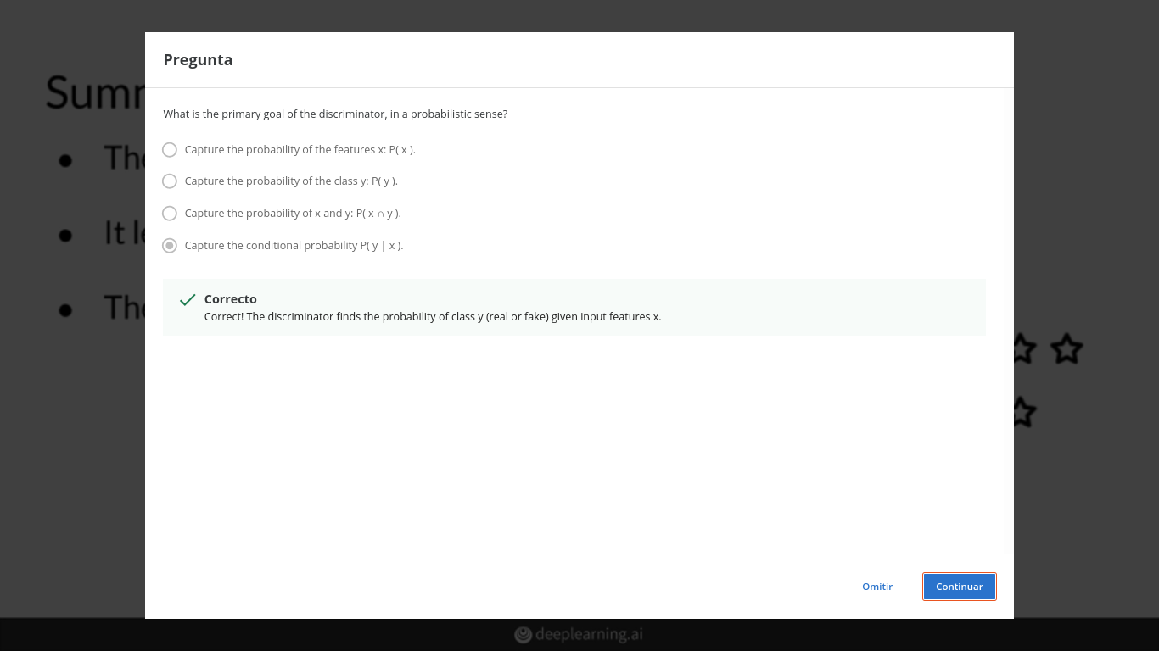

Slide 42
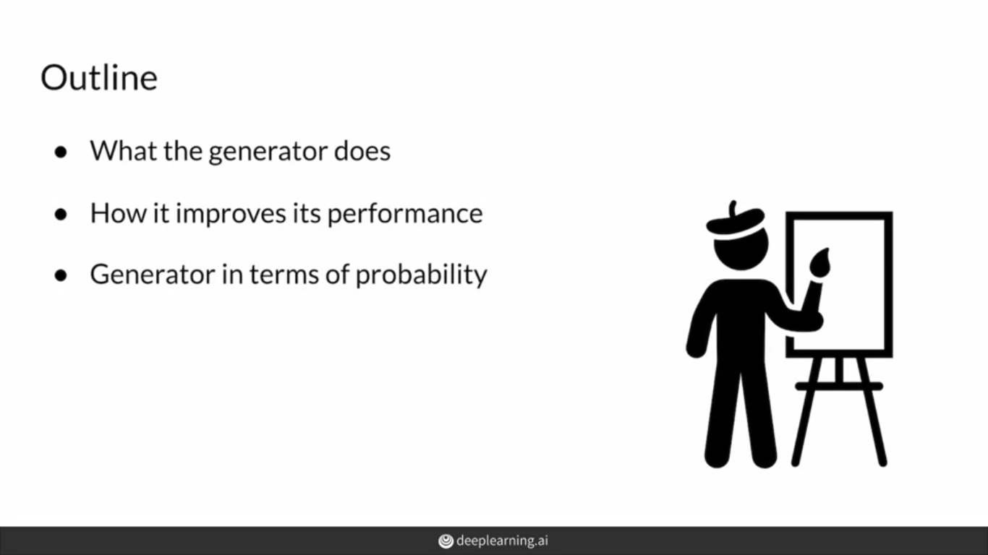

Slide 43
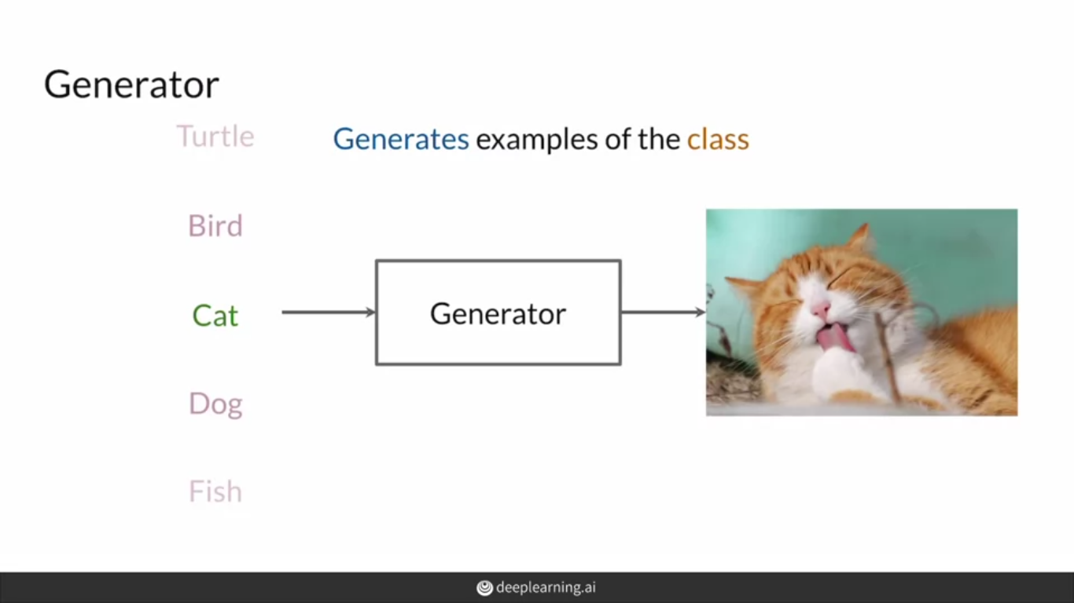

Slide 44
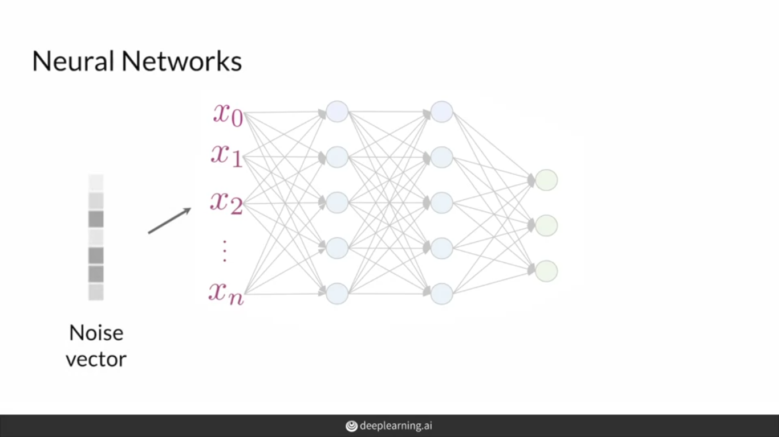

Slide 45
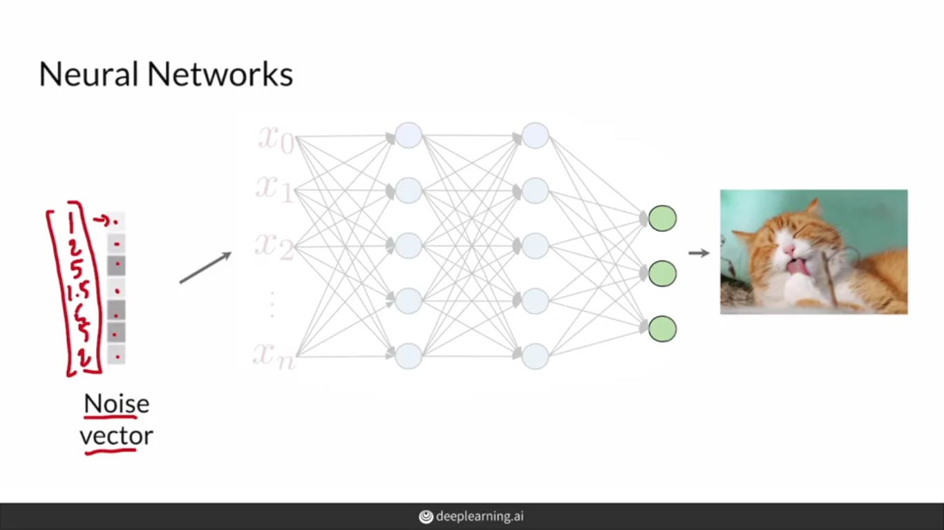

Slide 46
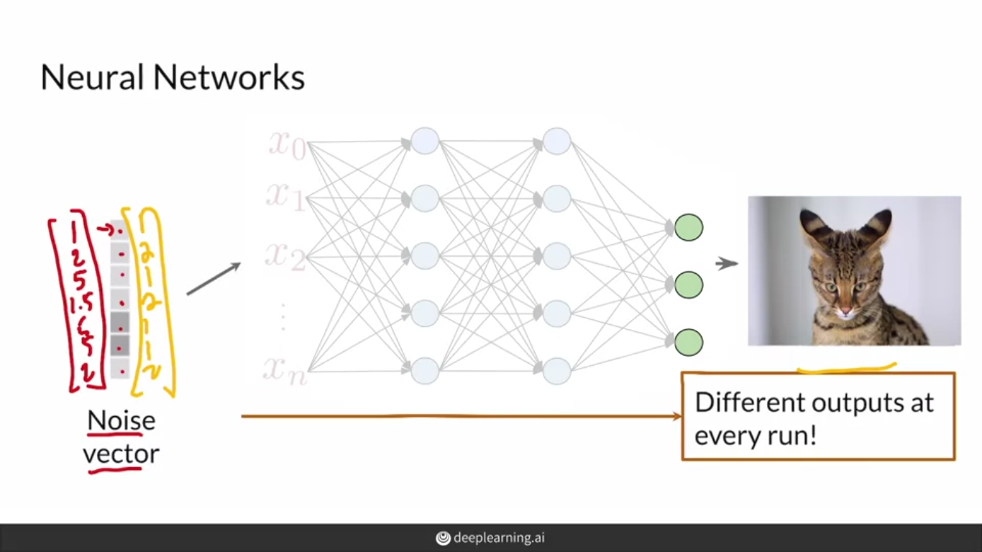

Slide 47
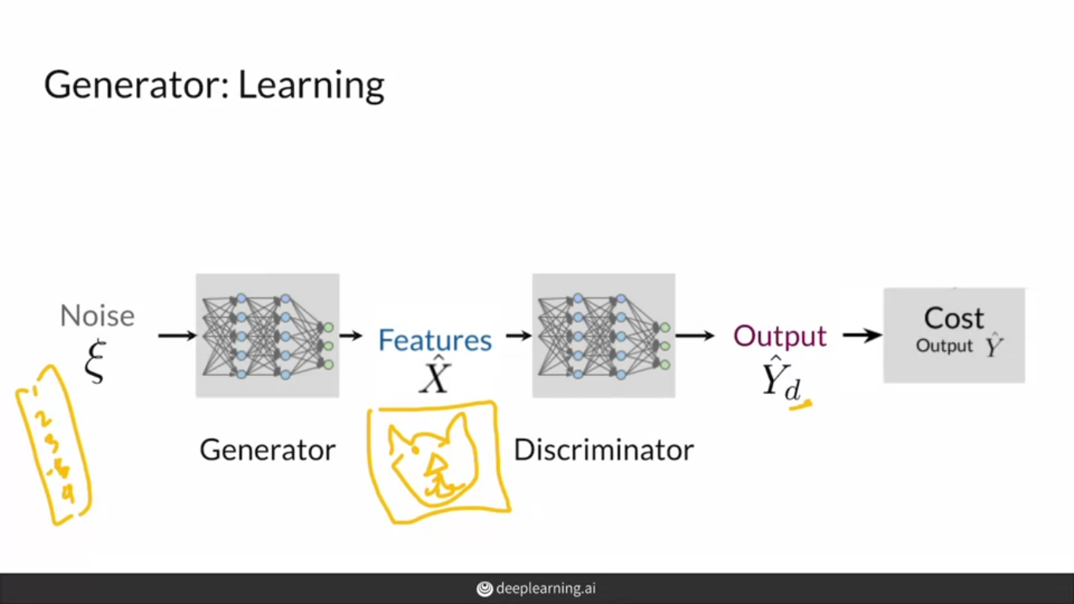

Slide 48
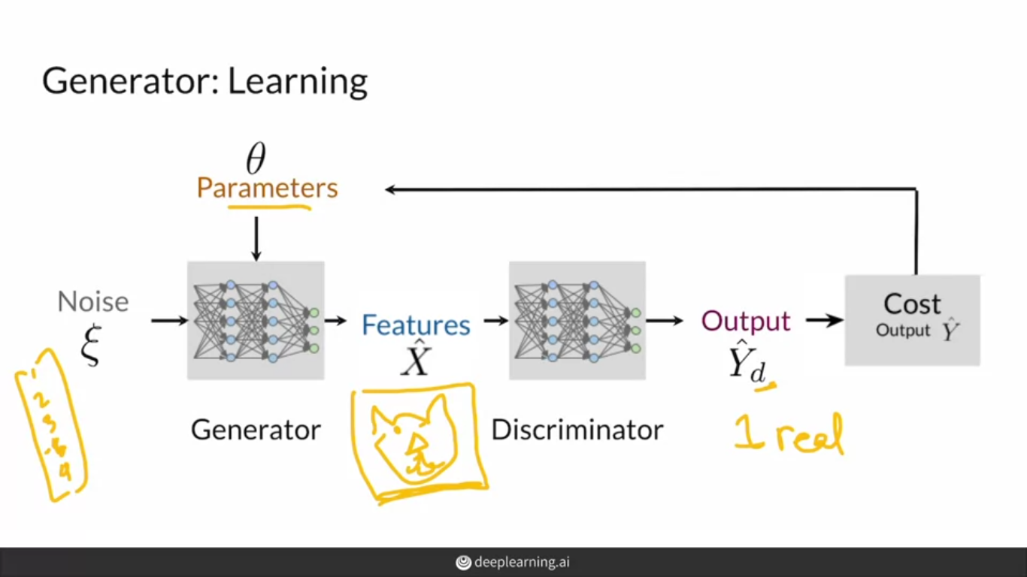

Slide 49
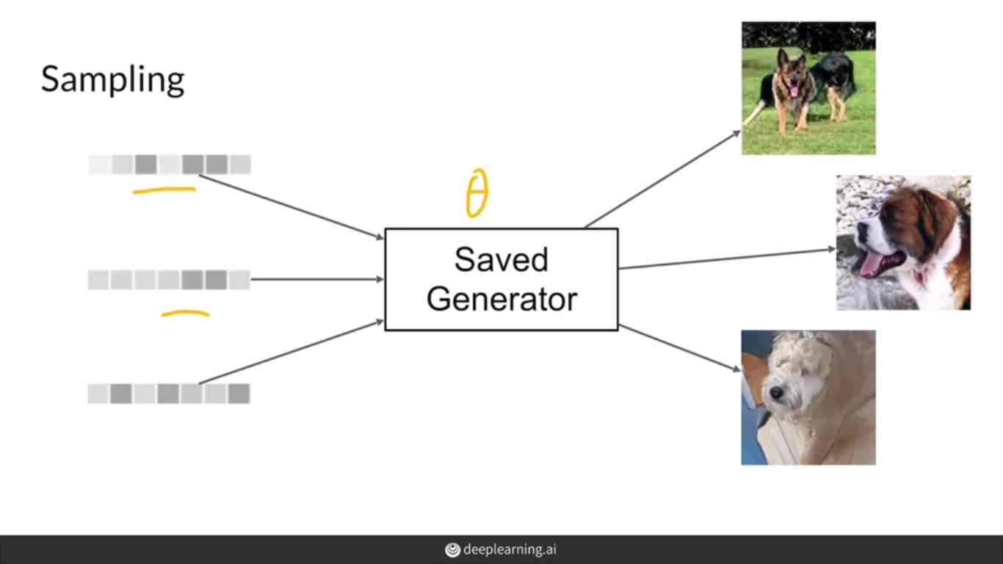

Slide 50
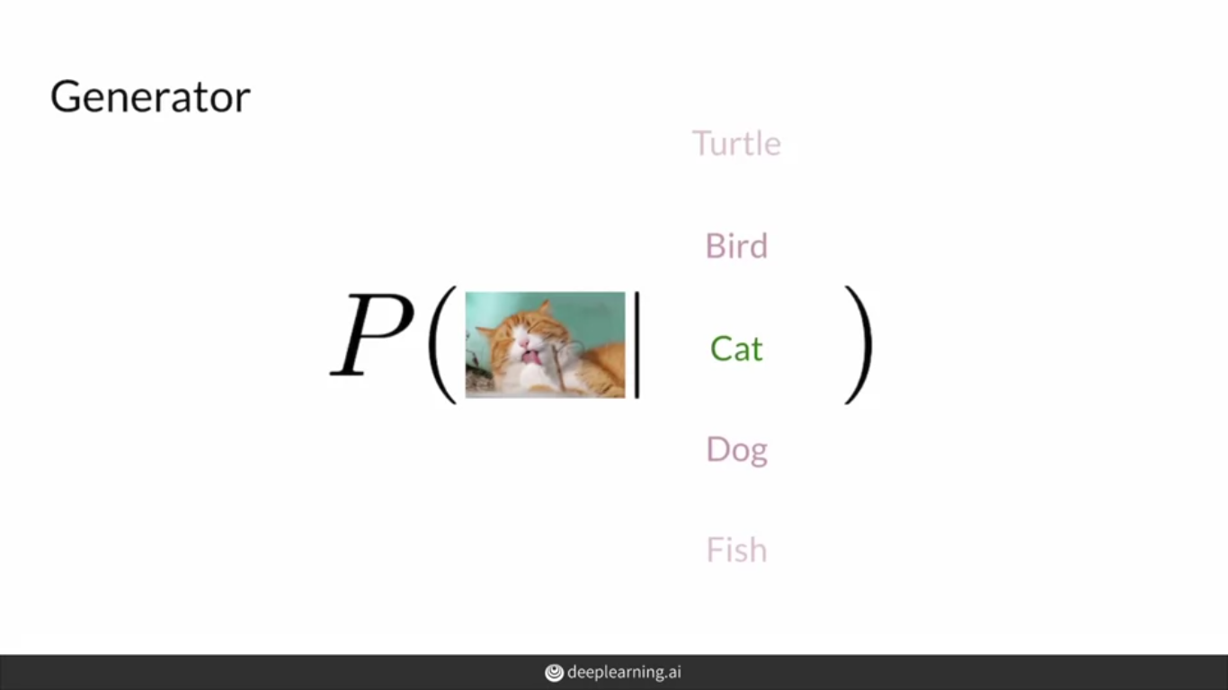

Slide 51
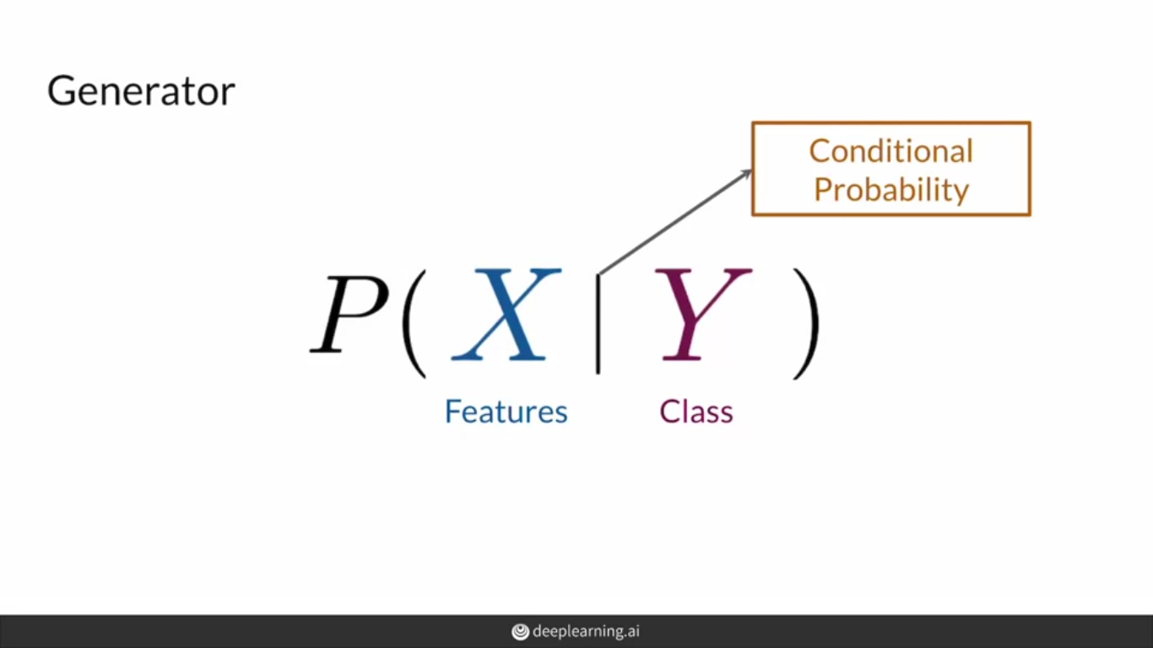

Slide 52
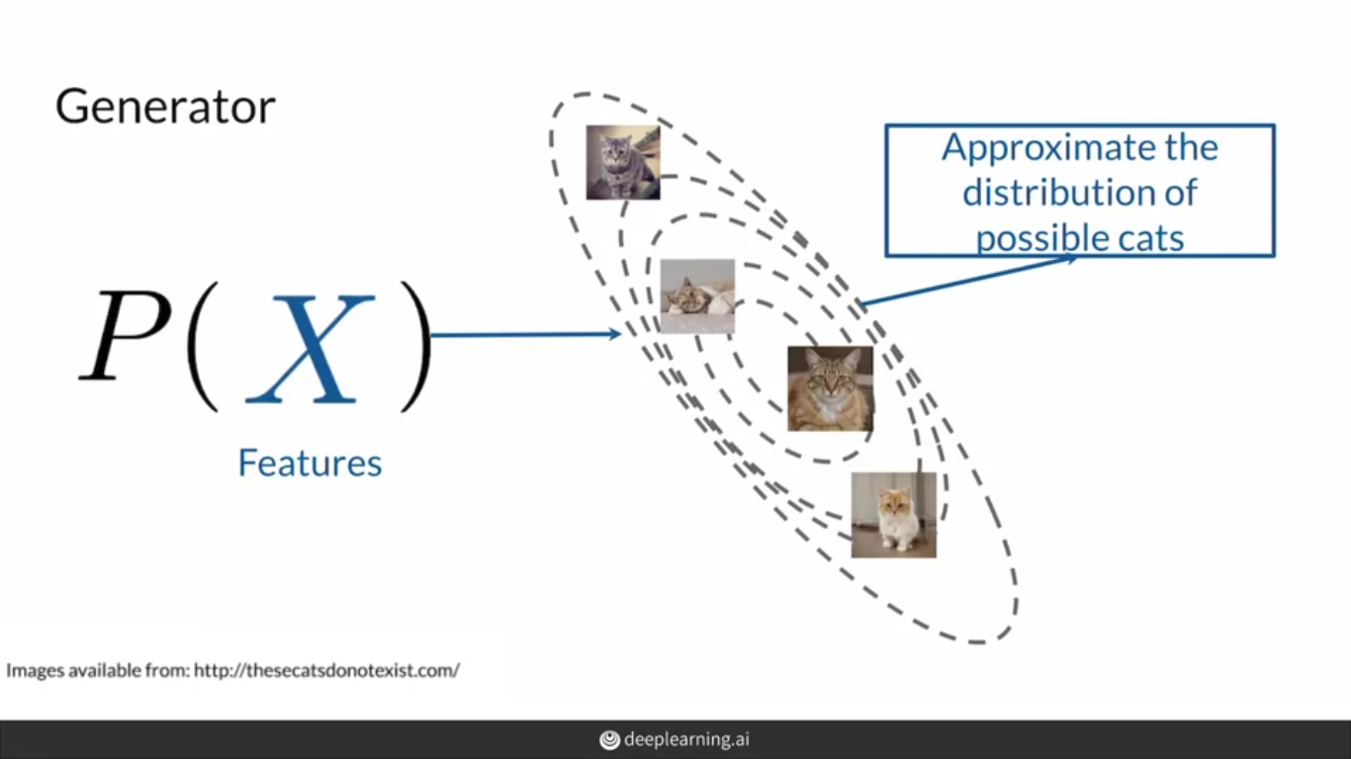

Slide 53


Slide 54


Slide 55


Slide 56


Slide 57


Slide 58


Slide 59


Slide 60


Slide 61


Slide 62


Slide 63


Slide 64


Slide 65


Slide 66


Slide 67


Slide 68


Slide 69


Slide 70


Slide 71


Slide 72


Slide 73


Slide 74


Slide 75


Slide 76


Slide 77


Slide 78


Slide 79


Slide 80


Slide 81


Slide 82
https://thegradient.pub/state-of-ml-frameworks-2019-pytorch-dominates-research-tensorflow-dominates-industry/

Slide 83
All of the resources cited in Course 1 Week 1, in one place. You are encouraged to explore these papers/sites if they interest you! They are listed in the order they appear in the lessons.
From the videos:
Hyperspherical Variational Auto-Encoders (Davidson, Falorsi, De Cao, Kipf, and Tomczak, 2018): https://www.researchgate.net/figure/Latent-space-visualization-of-the-10-MNIST-digits-in-2-dimensions-of-both-N-VAE-left_fig2_324182043
Analyzing and Improving the Image Quality of StyleGAN (Karras et al., 2020): https://arxiv.org/abs/1912.04958
Semantic Image Synthesis with Spatially-Adaptive Normalization (Park, Liu, Wang, and Zhu, 2019): https://arxiv.org/abs/1903.07291
Few-shot Adversarial Learning of Realistic Neural Talking Head Models (Zakharov, Shysheya, Burkov, and Lempitsky, 2019): https://arxiv.org/abs/1905.08233
Learning a Probabilistic Latent Space of Object Shapes via 3D Generative-Adversarial Modeling (Wu, Zhang, Xue, Freeman, and Tenenbaum, 2017): https://arxiv.org/abs/1610.07584
These Cats Do Not Exist (Glover and Mott, 2019): http://thesecatsdonotexist.com/
From the notebooks:
Large Scale GAN Training for High Fidelity Natural Image Synthesis (Brock, Donahue, and Simonyan, 2019): https://arxiv.org/abs/1809.11096
PyTorch Documentation: https://pytorch.org/docs/stable/index.html#pytorch-documentation
MNIST Database: http://yann.lecun.com/exdb/mnist/

Slide 84
Works Cited
All of the resources cited in Course 1 Week 2, in one place. You are encouraged to explore these papers/sites if they interest you—for this week, both papers have been included as optional readings! They are listed in the order they appear in the lessons.
From the videos:
Deconvolution and Checkerboard Artifacts (Odena et al., 2016): http://doi.org/10.23915/distill.00003
From the notebook:
Unsupervised Representation Learning with Deep Convolutional Generative Adversarial Networks (Radford, Metz, and Chintala, 2016): https://arxiv.org/abs/1511.06434
MNIST Database: http://yann.lecun.com/exdb/mnist/

